Slide 1
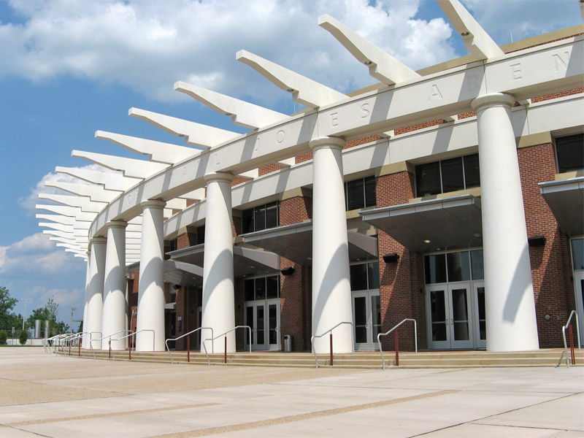
JOHN PAUL JONES ARENA
CHARLOTTESVILLE, VIRGINIA
FINAL DESIGN PRESENTATION
LOGAN BROWN
LIGHTING/ELECTRICAL OPTION
APRIL 28, 2009

Slide 2
ONE. | Project Overview
TWO. | Lighting Depth: Academic Center / Reading Room
THREE. | Athletic Dining Room
FOUR. | West Façade & Entry Lobby
FIVE. | Electrical Depth: Energy Efficient Transformer Analysis
SIX. | Structural Breadth: Effects of a Green Roof System
SEVEN. | Closing Remarks
FINAL DESIGN PRESENTATION: ORDER OF TOPICS

Slide 3
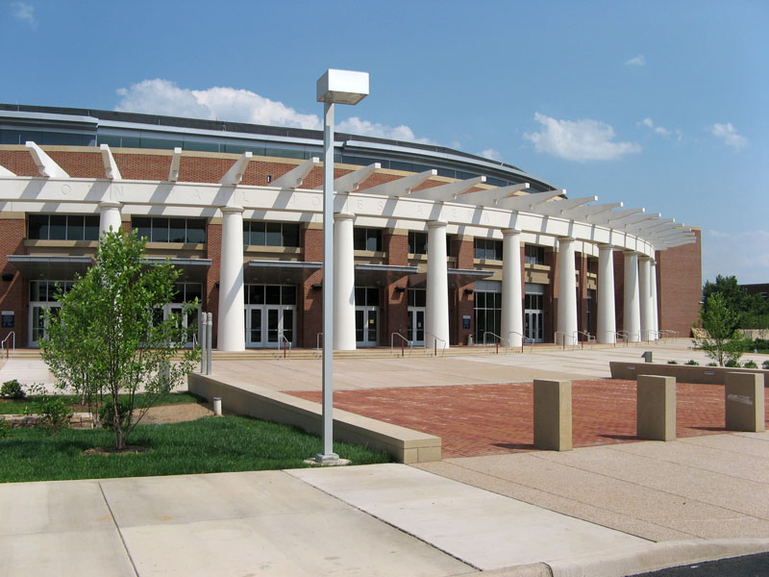
LOCATION:
The University of Virginia
295 Massie Road
Charlottesville, VA 22903
SIZE:
365,000 Square Feet
COST:
$129.8 Million (Overall Cost)
PROJECT TIMETABLE:
May 2003 – August 2006
PRIMARY FUNCTIONS:
16,000 Seat Arena
Team Store
Hall of Fame Museum
Concessions
Team Training Facilities
Educational Spaces
PRIMARY PROJECT TEAM:
Owner: The University of Virginia
Architect: VMDO Architects P.C.
Assoc. Architect: Ellerbe Becket
General Contractor: Barton Malow
Civil Engineer: Patton Harris Rust & Associates P.C.
Structural Engineer: Ellerbe Becket
MEP Engineer: Ellerbe Becket
Arena Signage: Workshop Design LLC
FINAL DESIGN PRESENTATION: PROJECT OVERVIEW

Slide 4
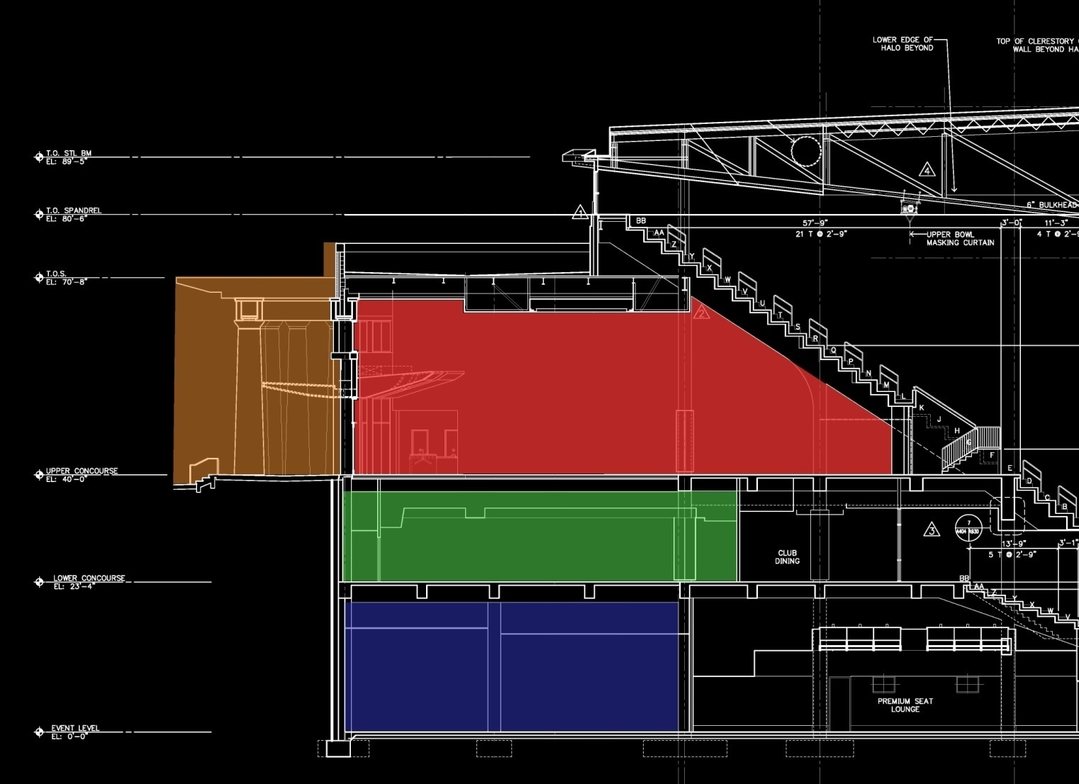
EXTERIOR FACADE
LOBBY
DINING ROOM
ACADEMIC CENTER
FINAL DESIGN PRESENTATION: PROJECT OVERVIEW

Slide 5
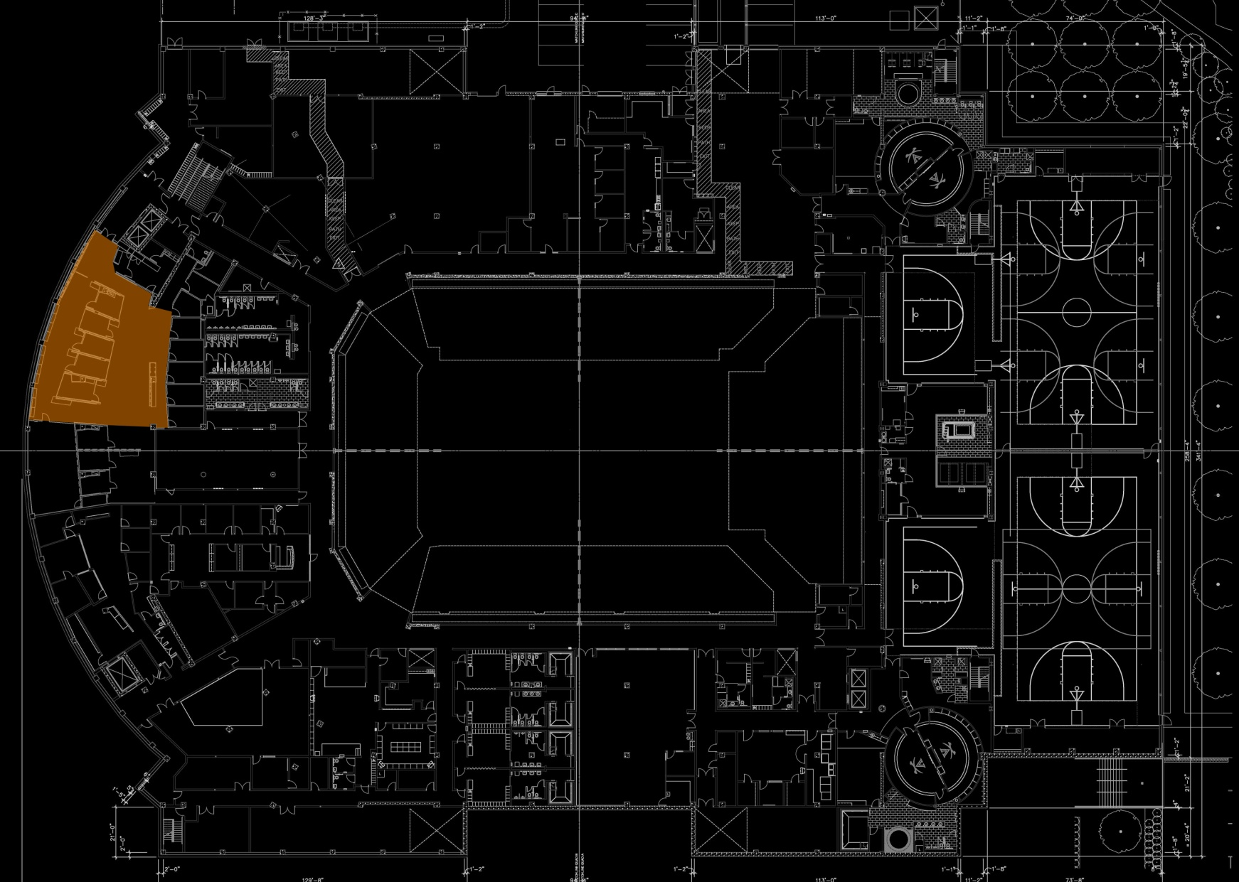
ACADEMIC CENTER
FINAL DESIGN PRESENTATION: PLAN VIEW

Slide 6
ACADEMIC CENTER
ONE. | Create a relaxed and open environment
TWO. | Uniform and proper light distribution on task plane
THREE. | Creation of room zones to account for occupancy issues
FINAL DESIGN PRESENTATION: DESIGN GOALS

Slide 7
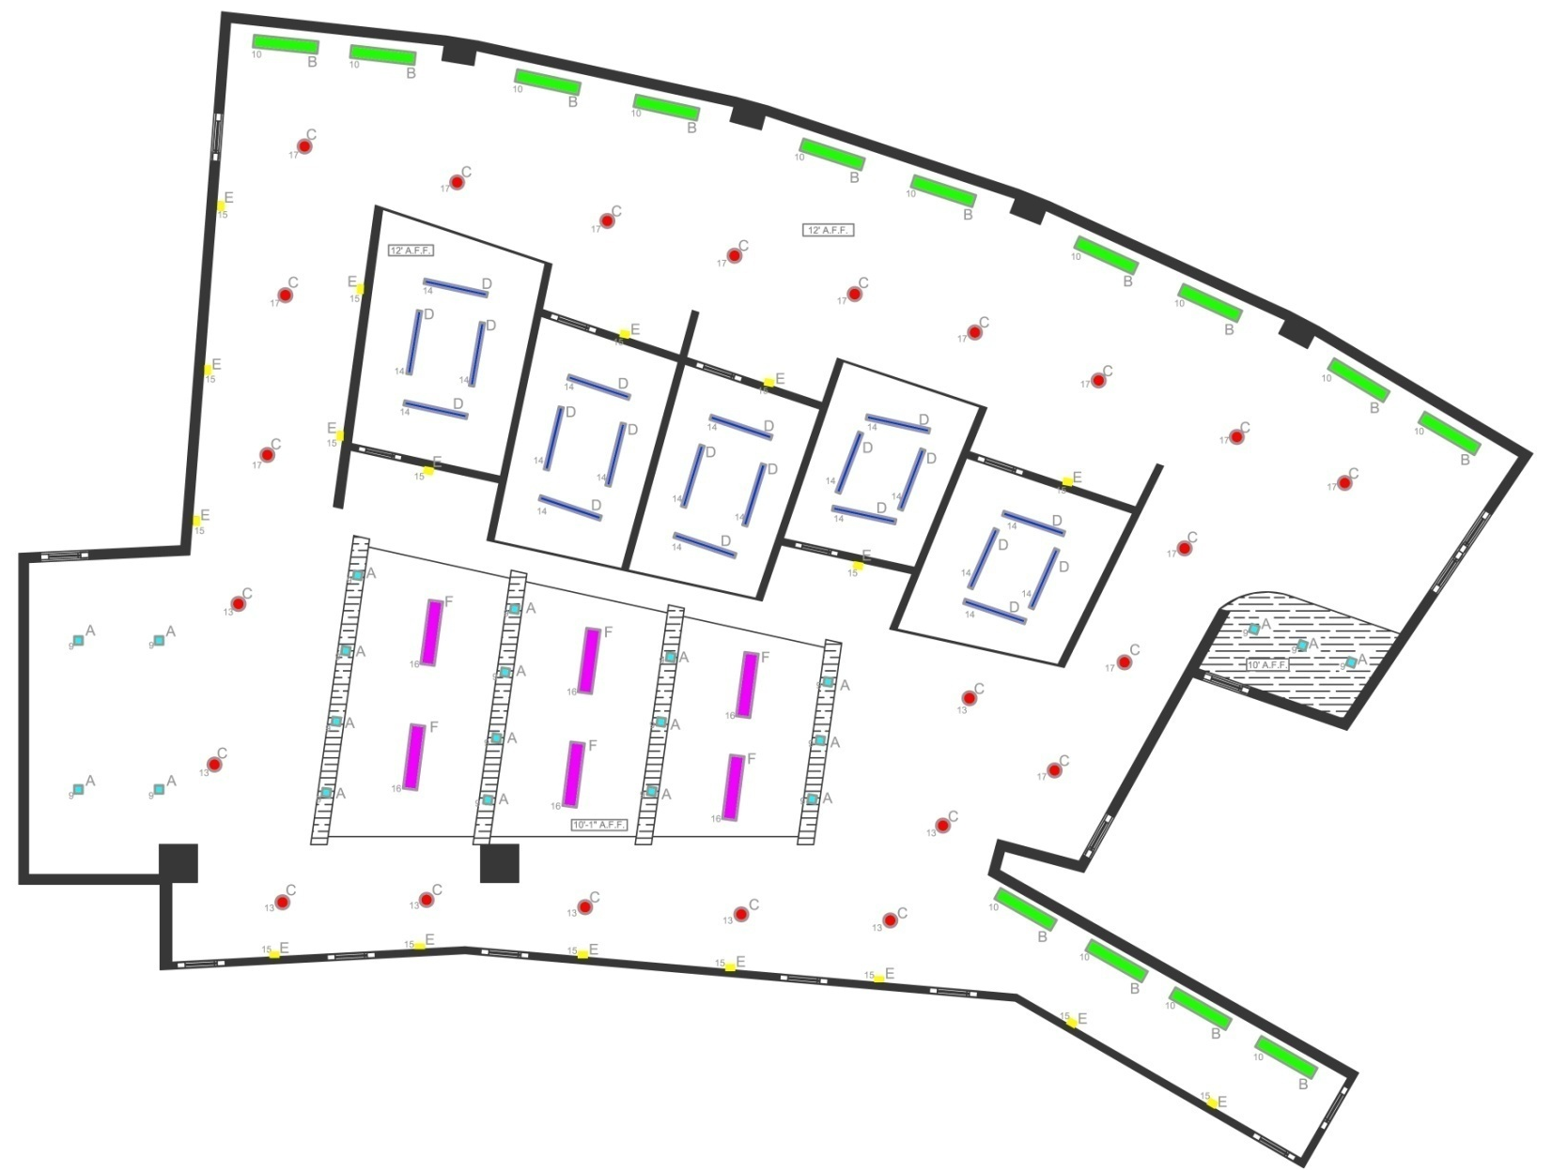
ACADEMIC CENTER
FINAL DESIGN PRESENTATION: FIXTURE PLAN

Slide 8
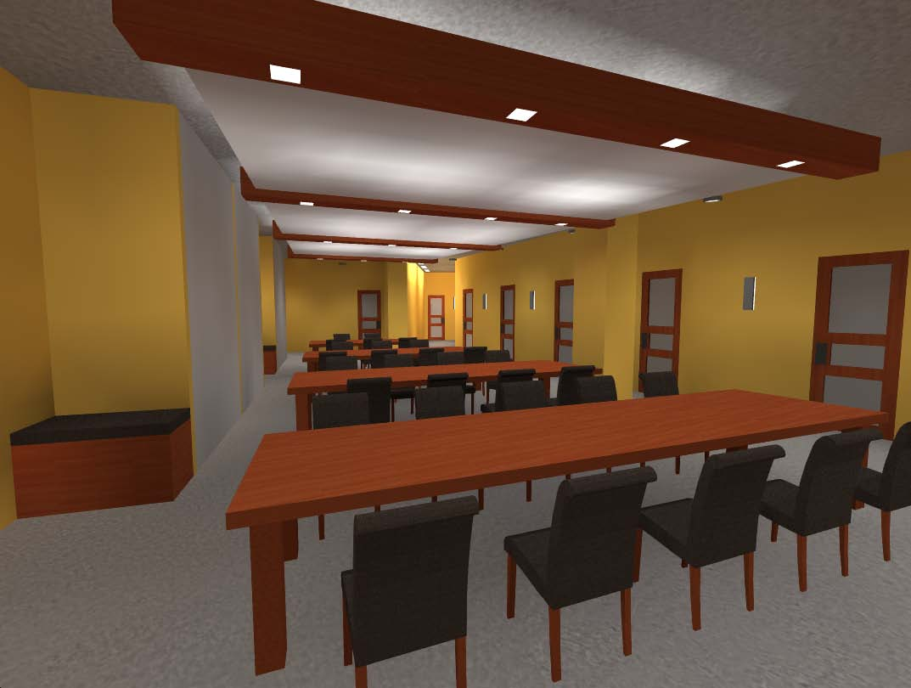
JOHN PAUL JONES ARENA
ACADEMIC CENTER
CHARLOTTESVILLE, VIRGINIA
FINAL DESIGN PRESENTATION: RENDERINGS

Slide 9
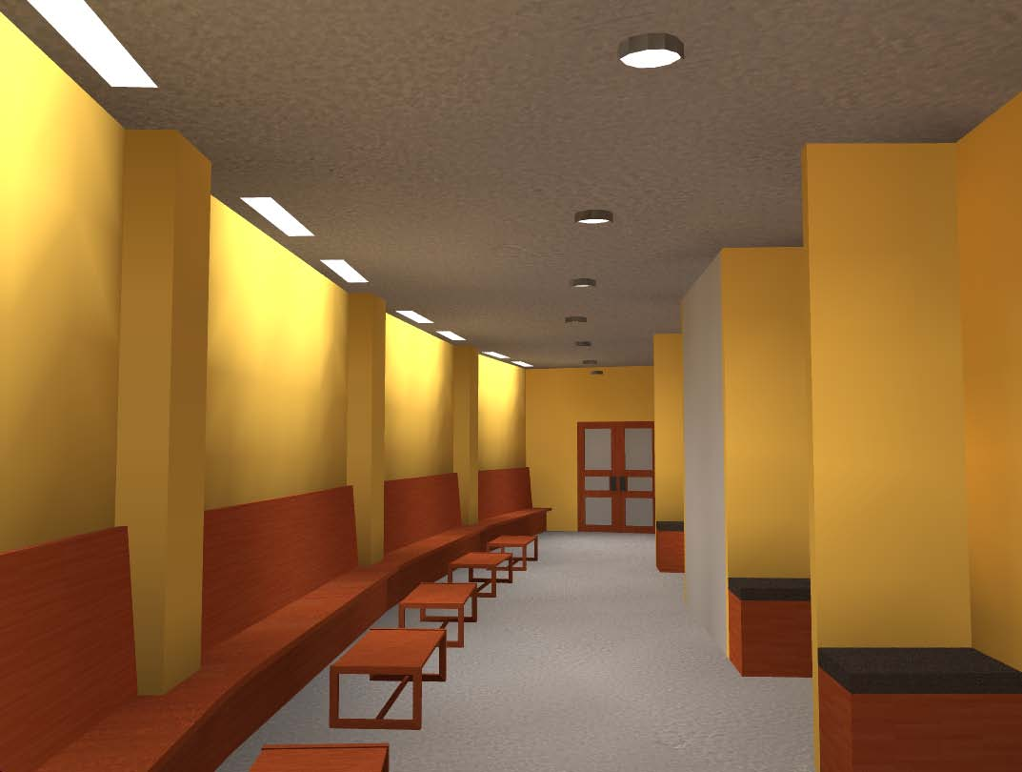
JOHN PAUL JONES ARENA
ACADEMIC CENTER
CHARLOTTESVILLE, VIRGINIA
FINAL DESIGN PRESENTATION: RENDERINGS

Slide 10
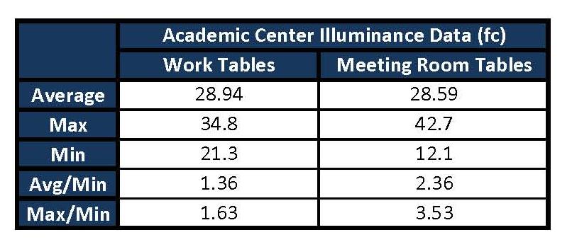
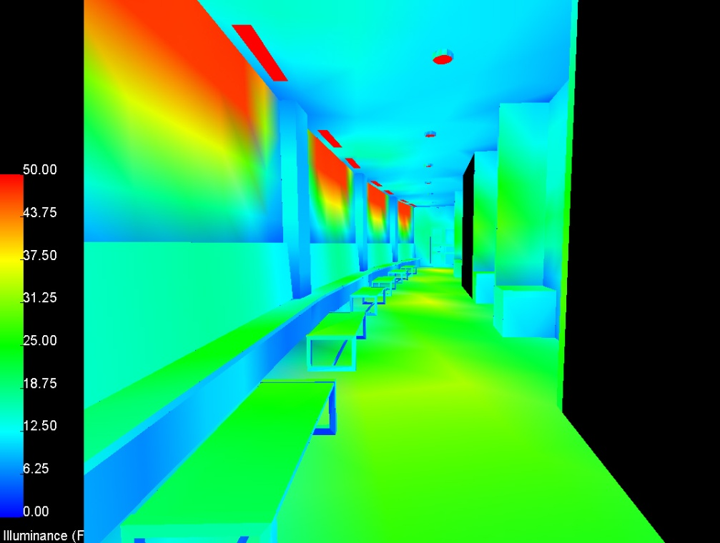
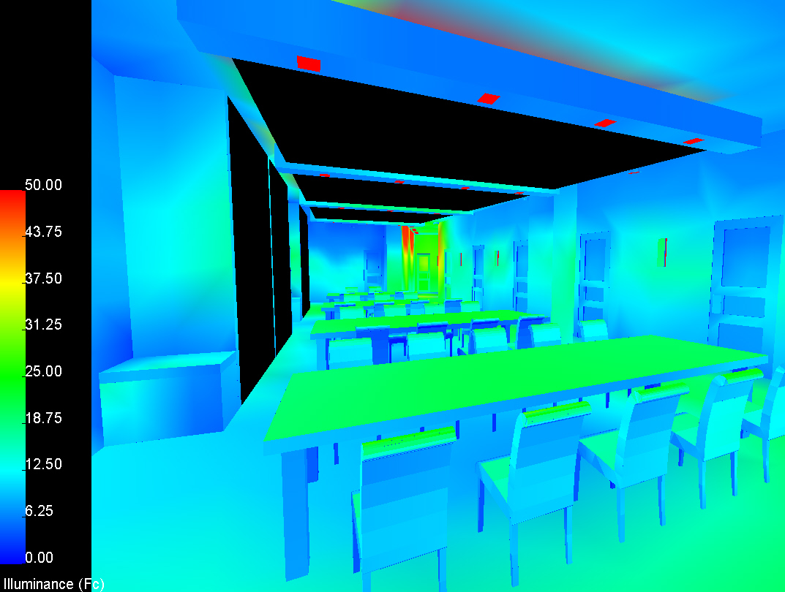
JOHN PAUL JONES ARENA
ACADEMIC CENTER
CHARLOTTESVILLE, VIRGINIA
FINAL DESIGN PRESENTATION: PSEUDO COLOR RENDERINGS

Slide 11
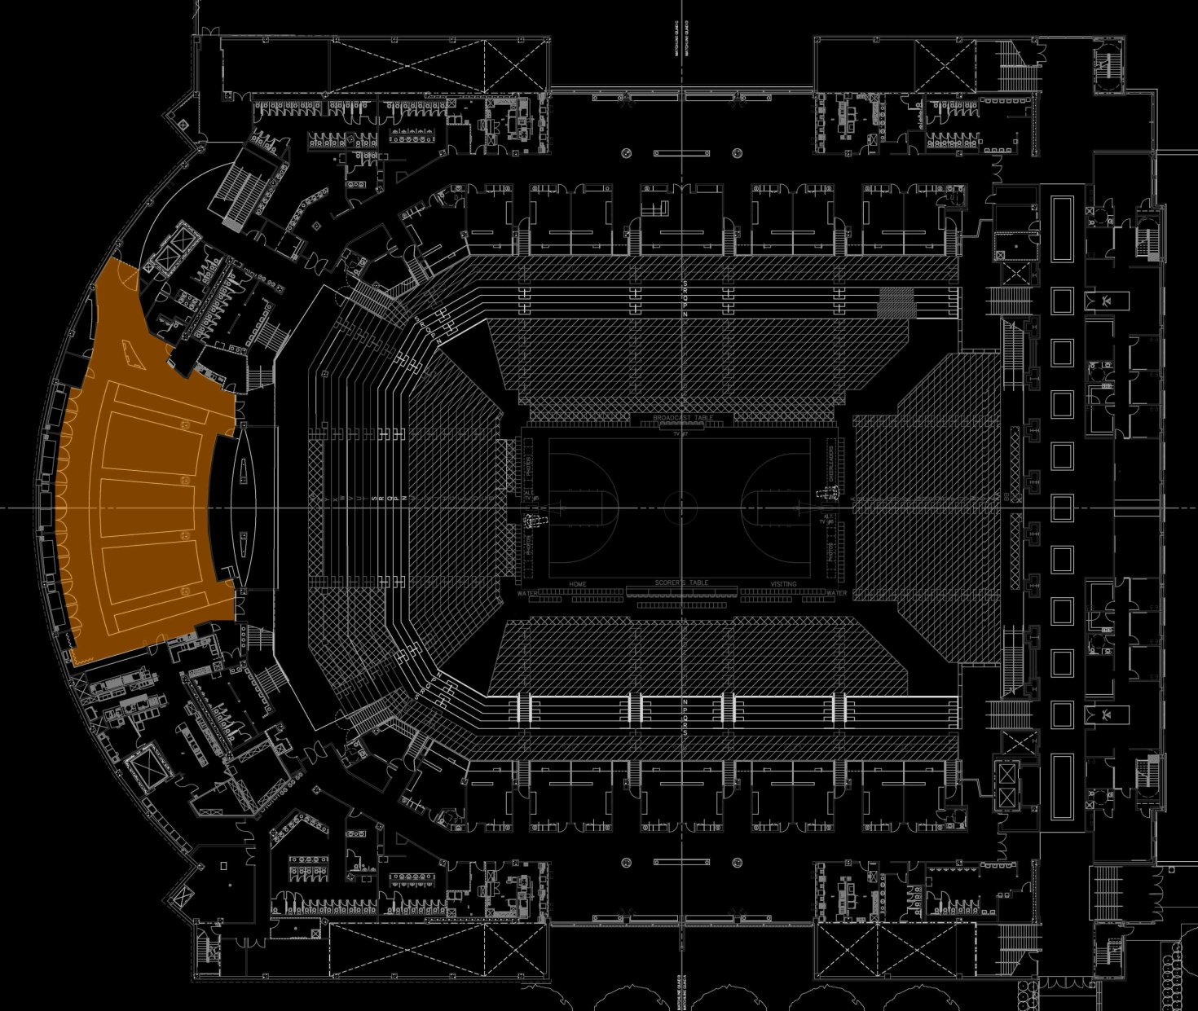
DINING ROOM
FINAL DESIGN PRESENTATION: PLAN VIEW

Slide 12
DINING ROOM
ONE. | Emphasize the ceiling heights as architectural features
TWO. | Create a spacious & professional environment
THREE. | Use of a visual hierarchy throughout the space
FOUR. | Controls to allow for video projection
FINAL DESIGN PRESENTATION: DESIGN GOALS

Slide 13
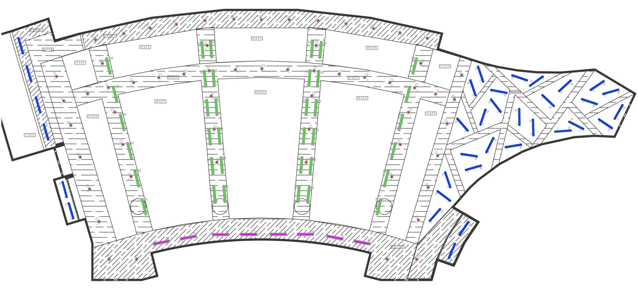
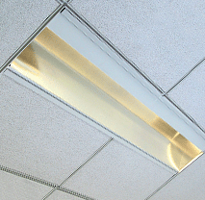
DINING ROOM
FINAL DESIGN PRESENTATION: LIGHTING PLAN

Slide 14
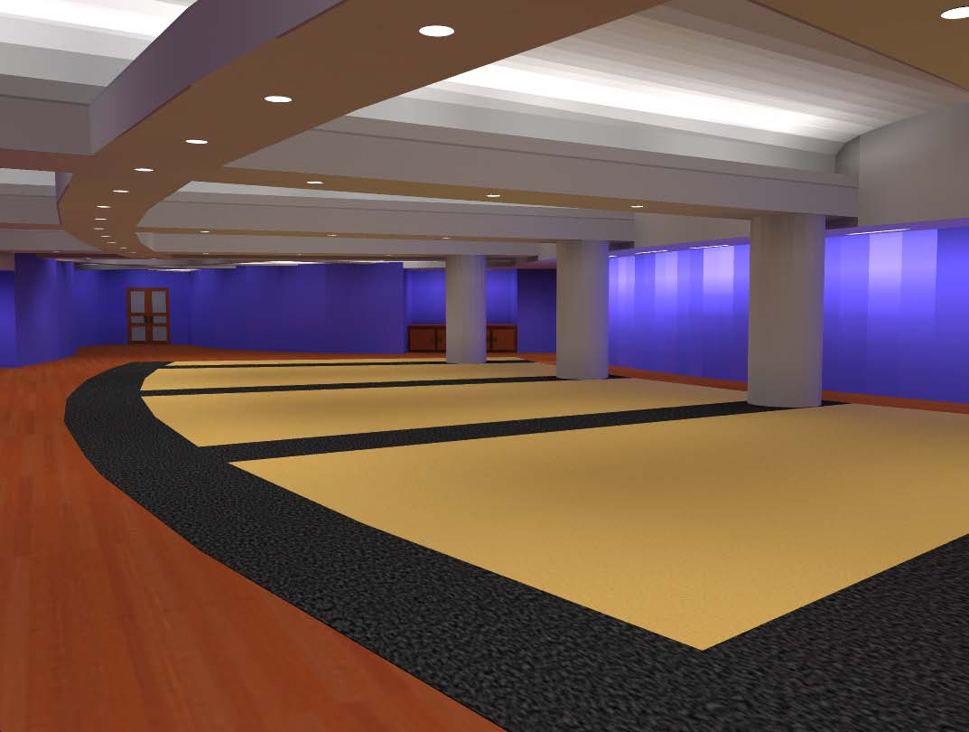
JOHN PAUL JONES ARENA
DINING ROOM
CHARLOTTESVILLE, VIRGINIA
FINAL DESIGN PRESENTATION: RENDERINGS

Slide 15
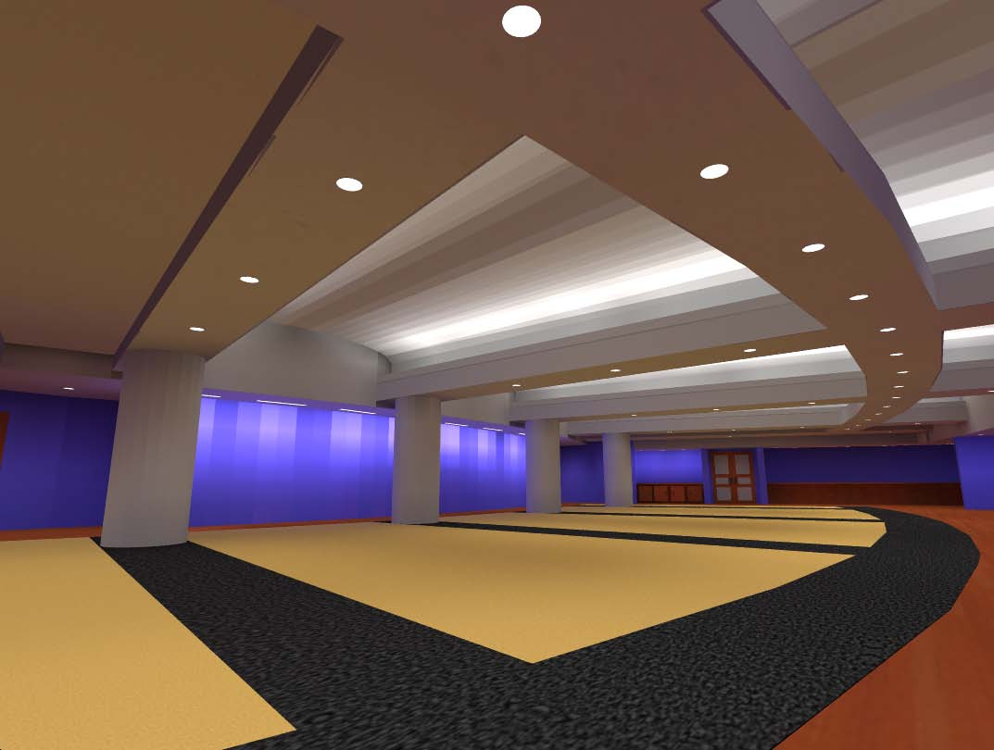
JOHN PAUL JONES ARENA
ACADEMIC CENTER
CHARLOTTESVILLE, VIRGINIA
FINAL DESIGN PRESENTATION: RENDERINGS

Slide 16
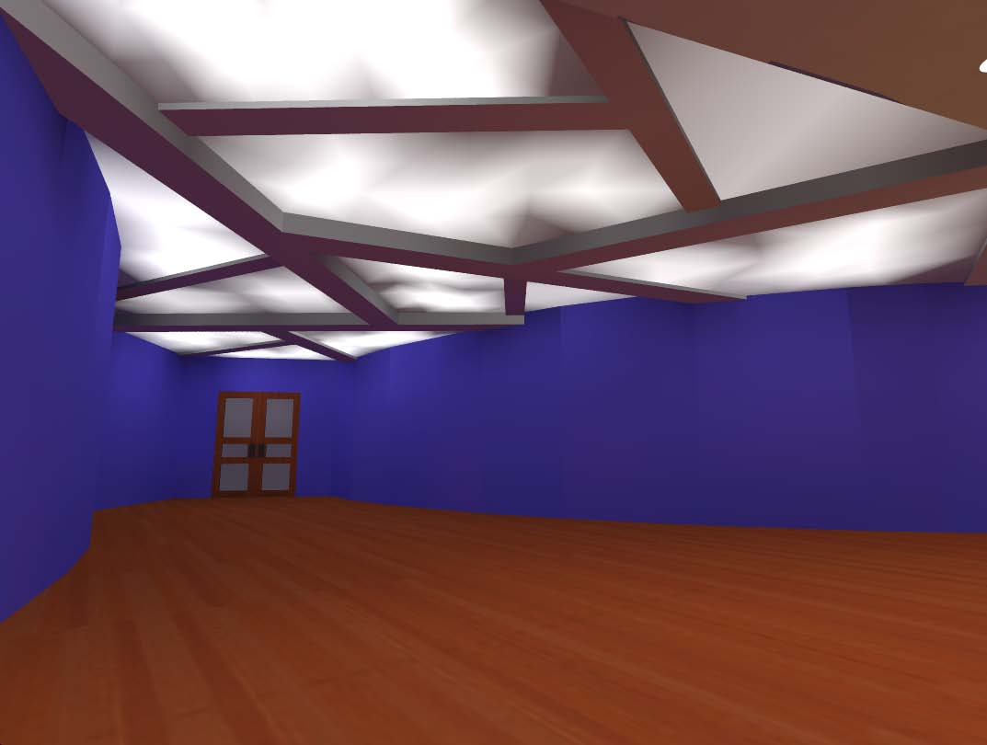
JOHN PAUL JONES ARENA
ACADEMIC CENTER
CHARLOTTESVILLE, VIRGINIA
FINAL DESIGN PRESENTATION: RENDERINGS

Slide 17
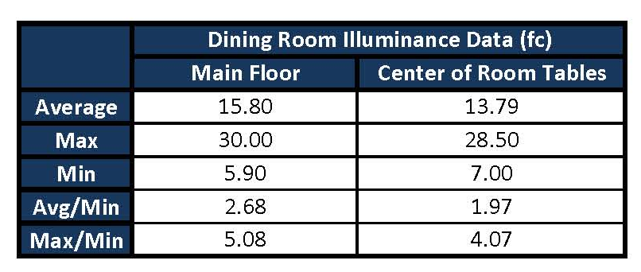
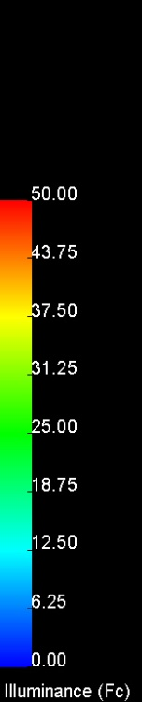

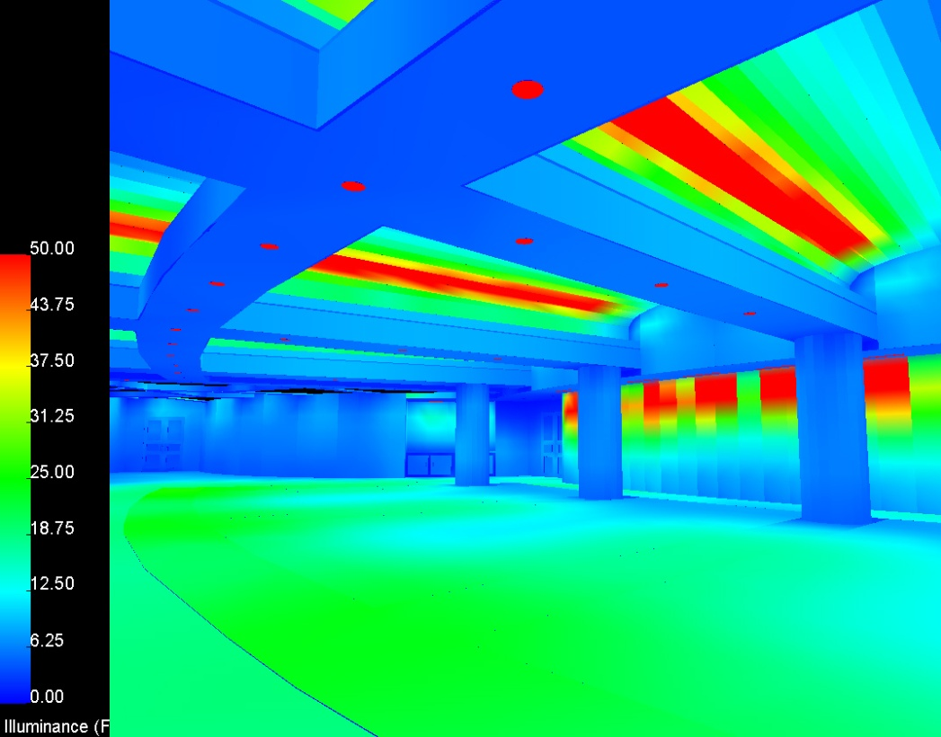
JOHN PAUL JONES ARENA
ACADEMIC CENTER
CHARLOTTESVILLE, VIRGINIA
FINAL DESIGN PRESENTATION: PSEUDO COLOR RENDERINGS

Slide 18
FAÇADE & ENTRY
ONE. | Match the historic theme of campus
TWO. | Clean and minimal lunimaire appearance
THREE. | Use of light to create visual depth and hierarchy
FOUR. | Accent major features while providing enough luminance for tasks
FINAL DESIGN PRESENTATION: DESIGN GOALS

Slide 19
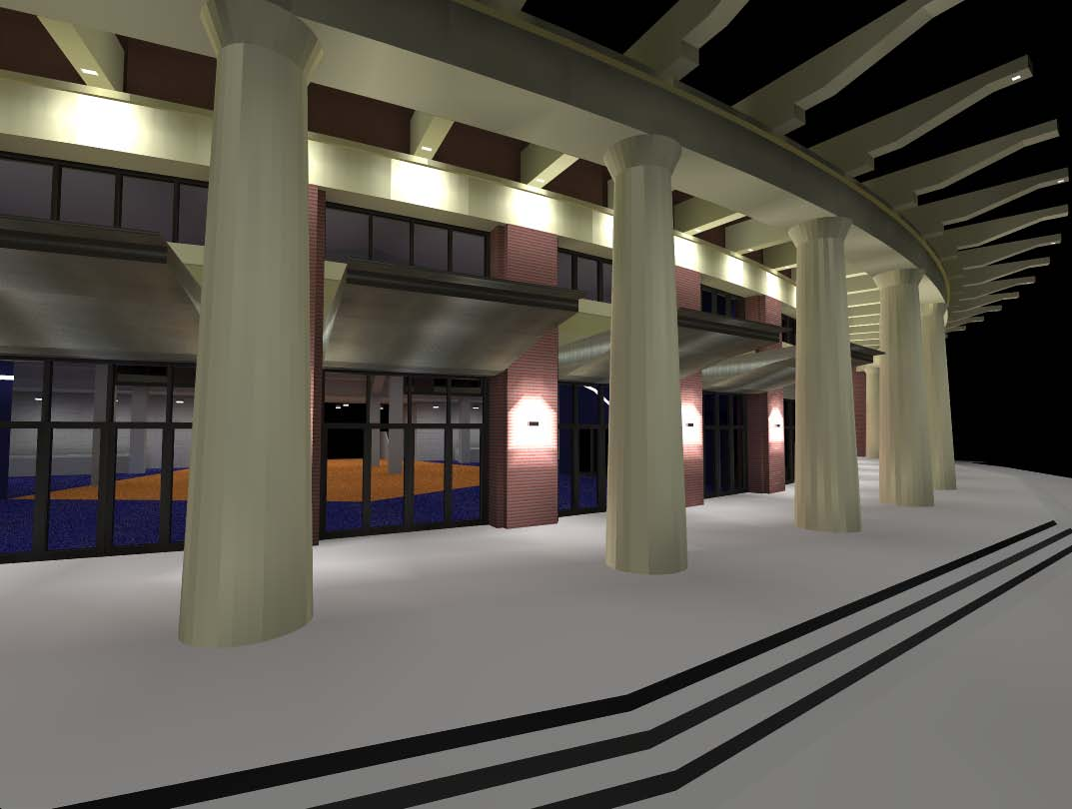
FAÇADE & ENTRY
FINAL DESIGN PRESENTATION: RENDERINGS

Slide 20
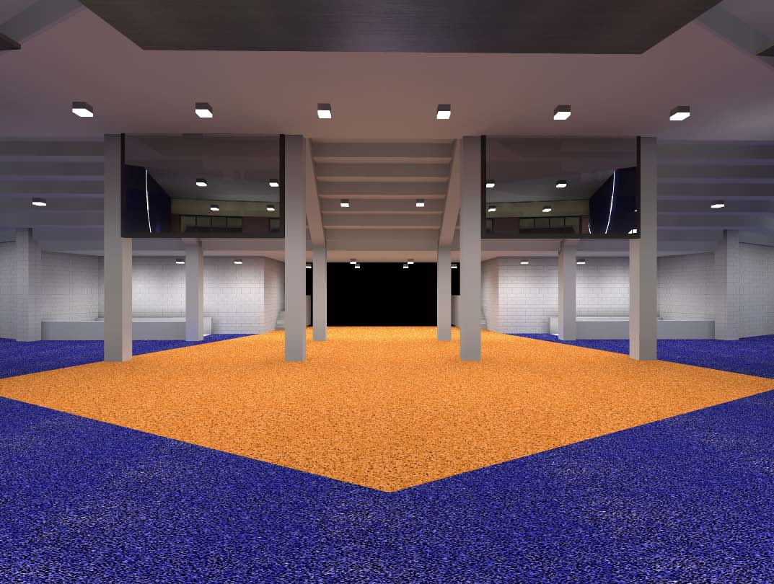
FAÇADE & ENTRY
FINAL DESIGN PRESENTATION: RENDERINGS

Slide 21
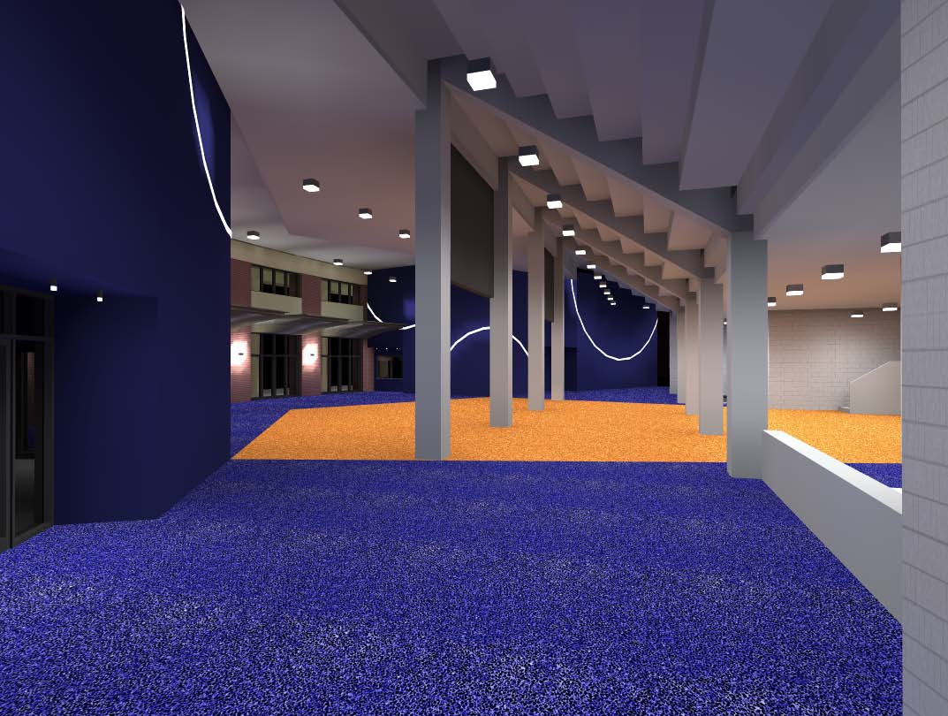
FAÇADE & ENTRY
FINAL DESIGN PRESENTATION: RENDERINGS

Slide 22
TRANSFORMER ANALYSIS
ONE. | Reduction in annual energy costs
TWO. | Relatively short payback period
THREE. | More efficient, Energy-Star compliant building
FINAL DESIGN PRESENTATION: GOALS

Slide 23
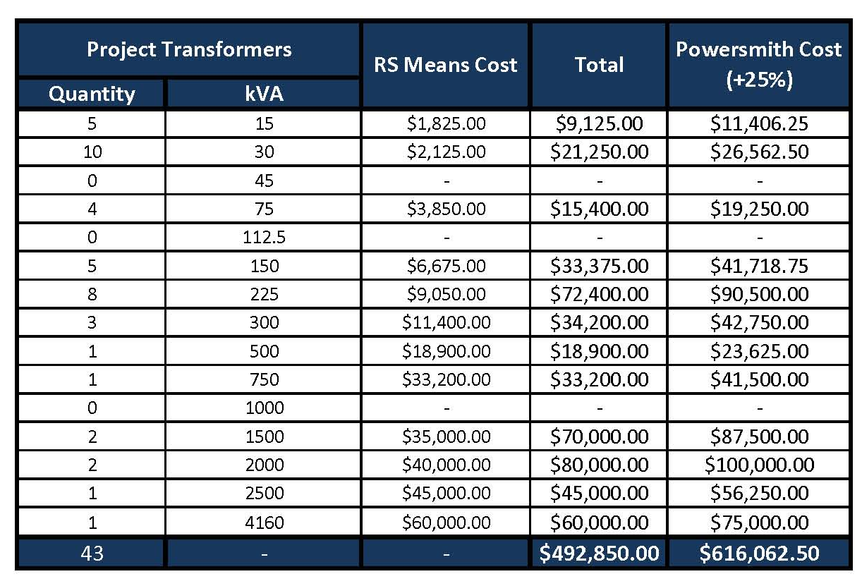
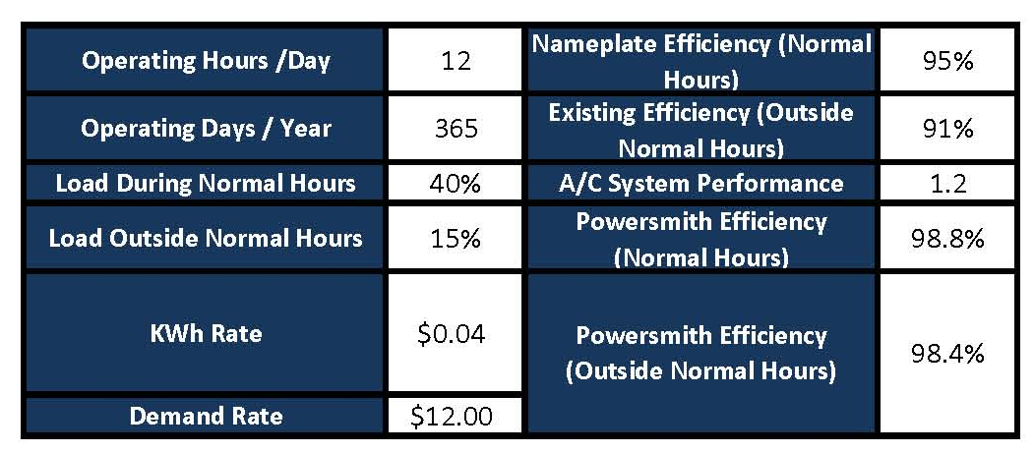
TRANSFORMER ANALYSIS
FINAL DESIGN PRESENTATION: COST STUDY & ASSUMPTIONS

Slide 24
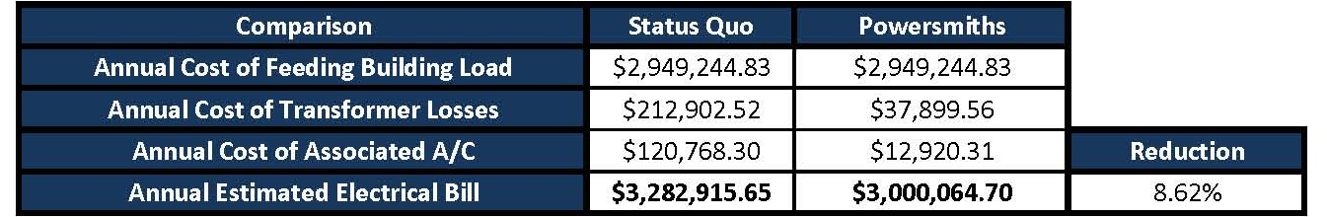
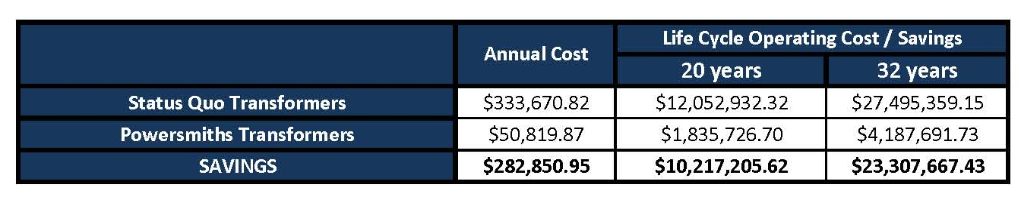

TRANSFORMER ANALYSIS
FINAL DESIGN PRESENTATION: STUDY SUMMARY

Slide 25
STRUCTURAL BREADTH
ONE. | Feasibility of a Green Roof System on an athletic arena
TWO. | Limit impact on existing structural design
FINAL DESIGN PRESENTATION: GOALS

Slide 26
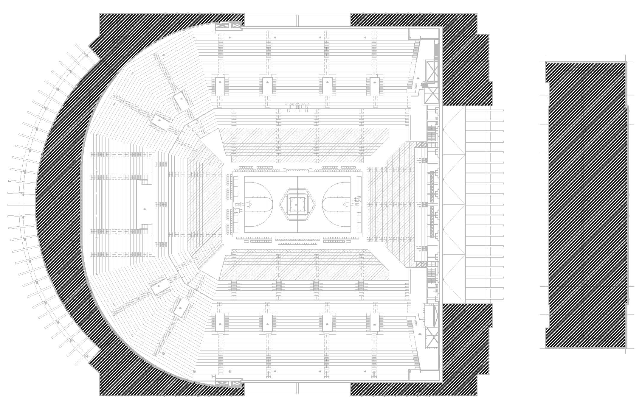
STRUCTURAL BREADTH
FINAL DESIGN PRESENTATION: PROPOSED REDESIGN AREA

Slide 27
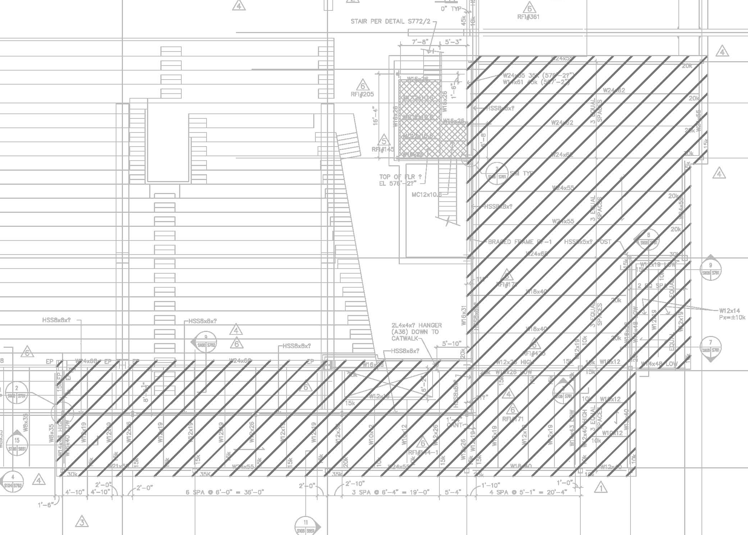
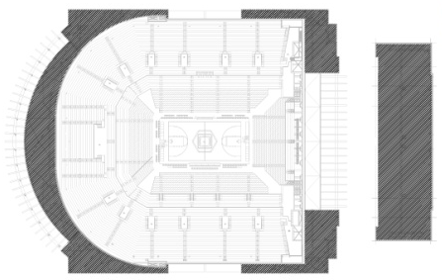
STRUCTURAL BREADTH
FINAL DESIGN PRESENTATION: CONCENTRATION AREA

Slide 28
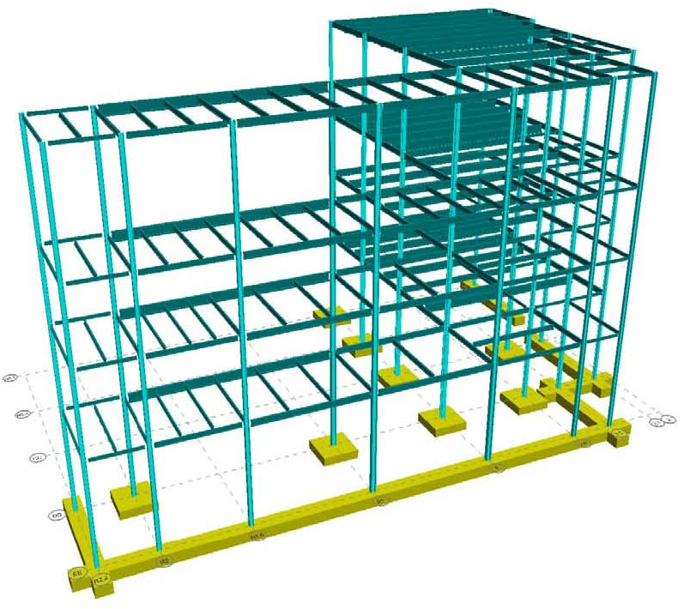
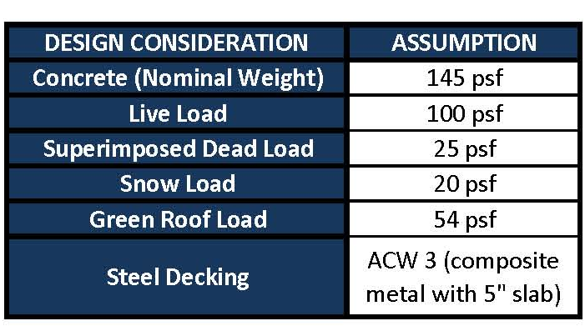
STRUCTURAL BREADTH
FINAL DESIGN PRESENTATION: RAM ASSUMPTIONS & MODEL

Slide 29
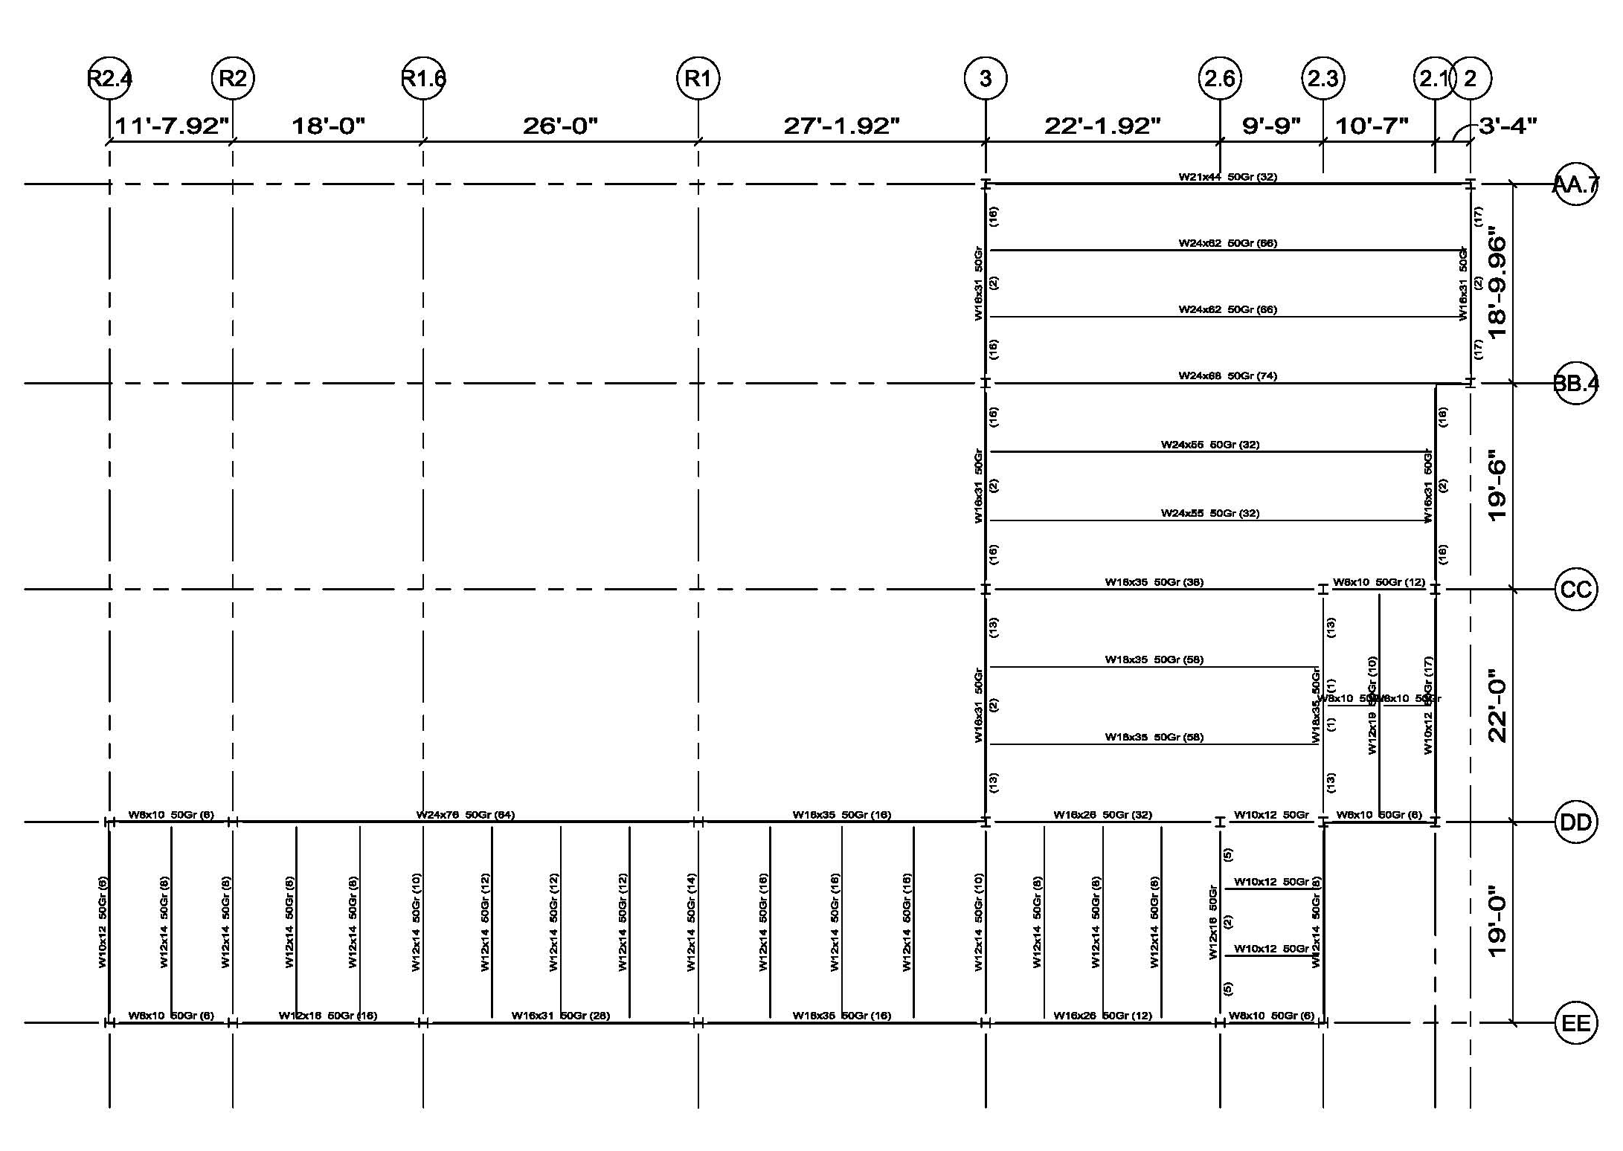
STRUCTURAL BREADTH
FINAL DESIGN PRESENTATION: SYSTEM REDESIGN

Slide 30
FINAL REMARKS
FINAL DESIGN PRESENTATION

Slide 31
ACKNOWLEDGEMENTS
Family & Friends
Dad
Mom
Little Broski
Bill and Connie
Nana
Gram
AE Faculty
Dr. Richard Mistrick
Dr. Kevin Houser
Professor Ted Dannerth
Professor Robert Holland
Professor Kevin Parfitt
Ellerbe Becket
Jim Hamm
Paula Gillette
Vittorio Ansourian
VMDO Architects
Bob Moje
The University of Virginia
Jon Oliver
Jason Bauman
FINAL DESIGN PRESENTATION

Slide 32
QUESTIONS ?
FINAL DESIGN PRESENTATION

